Slide 1
Mouse Glove
Wireless mouse controlled with hand motions
For people that are not able to use a regular mouse
Easy, good user experience and affordable
Amina Gojak
Yuzhen Liu
Tong He

Slide 2
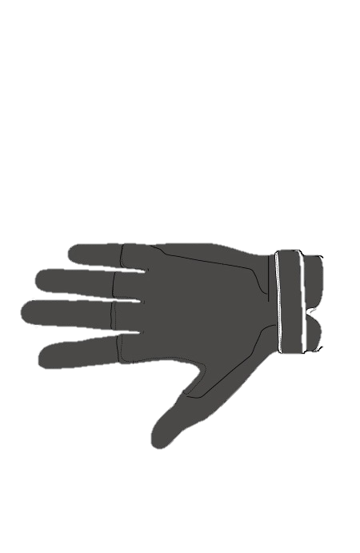

Structure Details
Feedback Unit
Vibrator (Micro-Motor) 8*9.5mm
Flex Sensor
ADC
Power Unit
Batteries 6LR61 9V
Raspberry
Pi
Wired or Wireless
Gesture Sensor
MPU6050
Accelerometer 1kHz
Gyrometer 8kHz
Input Unit
PC
Touch buttons Electrode Pad

